Slide 1
CSC 101 – Introduction to Computing
Lecture 3-4

Slide 2
Outline
Memory
Memory Hierarchy
Storage Devices:
Magnetic Storage Devices
Optical Storage Devices
Solid State Storage Devices
Data Read & Write Process.

Slide 3
Memory
Memory
Refers to chip-based storage located inside the system unit
Storage refers to the amount of long-term storage
available to a computer
Random Access Memory (RAM)
Computer’s main memory
Consists of chips arranged on a circuit board called a memory module which are plugged into the motherboard
Stores essential parts of operating system, programs, and data the computer is currently using

Slide 4
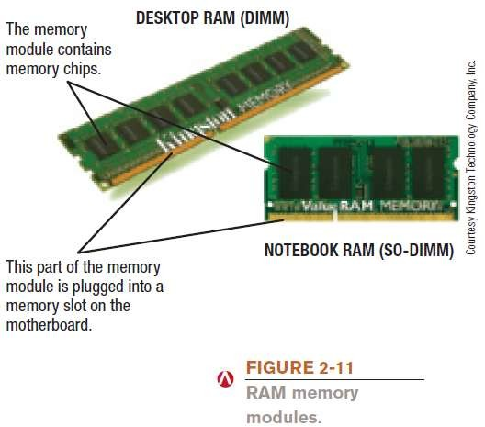
Memory

Slide 5
Memory
Volatile
RAM content lost when the computer is shut off
ROM and flash memory are non-volatile
Measured in bytes
Amount installed depends on the CPU and operating system being used
Most personal computers use SD-RAM
MRAM and PRAM - non-volatile RAM under development

Slide 6

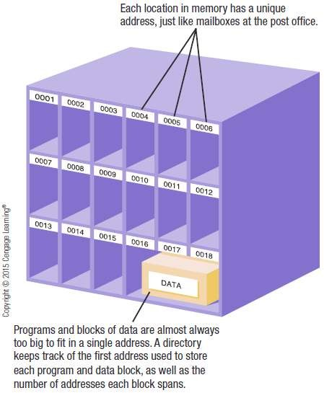
Memory
Each location in memory has an address
Each location typically holds one byte
Computer system sets up and maintains directory tables to facilitate retrieval of the data

Slide 7
Memory
Registers
High-speed memory built into the CPU
Used to store data and intermediary results during
processing
Fastest type of memory
ROM (read-only memory)
Non-volatile chips located on the motherboard into which data or programs have been permanently stored
Retrieved by the computer when needed
Being replaced with flash memory

Slide 8
Memory
Flash Memory
Nonvolatile memory chips that can be used for storage
Have begun to replace ROM for storing system
information
Now stores firmware for personal computers and other devices
Built into many types of devices (media tablets, mobile phones, and digital cameras) for user storage

Slide 9
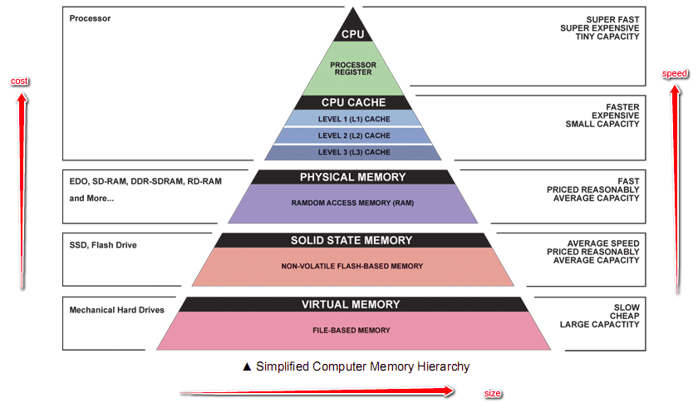
Memory Hierarchy

Slide 10
Storage System Characteristics
Storage Media and Storage Devices
Medium
Hardware where data is stored
DVD disc, flash memory card, etc.
Device
DVD drive, flash memory card reader, etc.
Medium is inserted into device to be used
Can be internal, external, or remote
Storage devices are typically identified by letter

Slide 11
Storage System Characteristics
Volatility
Storage media are nonvolatile
Random vs. Sequential Access
Random access (direct access) allows data to be retrieved from any location on the storage medium
Virtually all storage devices use random access
Sequential access means retrieval of data can occur only in the order in which it was physically stored on the storage medium
Magnetic tape drive

Slide 12
Storage System Characteristics
Logical vs. Physical Representation
File
Anything stored on a storage medium, such as a
program, document, digital image, or song
Filename
Name given to a file by the user
Folder
Named place on a storage medium into which files can be stored

Slide 13
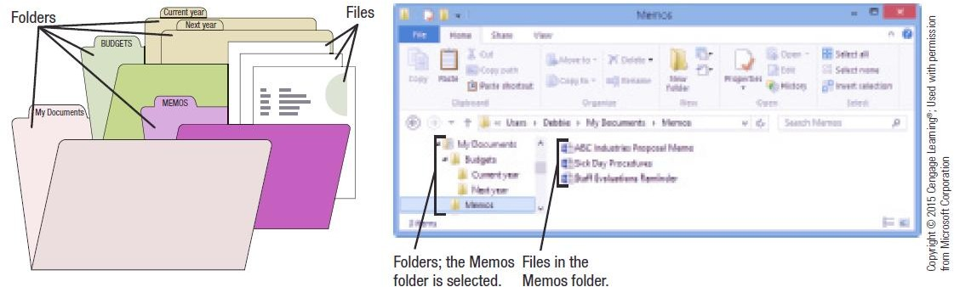
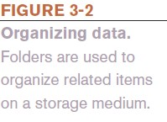
Storage System Characteristics

Slide 14
Storage System Characteristics
Logical file representation
Individuals view a document stored as one complete unit in a particular folder on a particular drive
Physical file representation
Computers access a particular document stored on a storage medium using its physical location or locations
Types of Storage Technology Used
Magnetic (conventional hard drives)
Optical (optical discs)
Electrons (flash memory media)

Slide 15
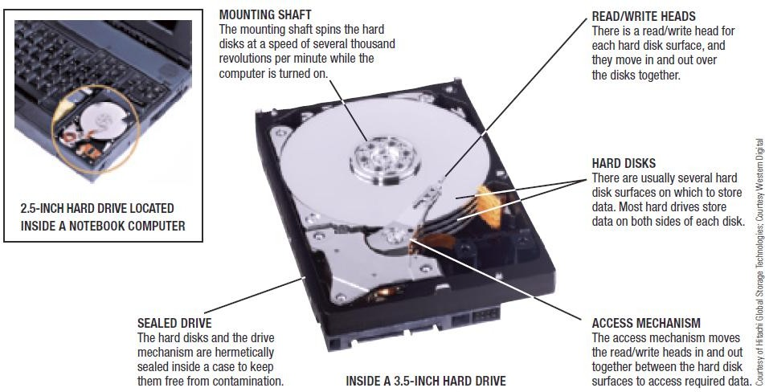

Hard Drives

Slide 16
Hard Drives
Hard disks are divided into:
Tracks
Concentric path on disk where data is recorded
Sectors
A small piece of the track
Clusters
One or more sectors; smallest addressable area of a disk
Cylinders
Collection of tracks located in the same location on a set of hard disk surfaces

Slide 17
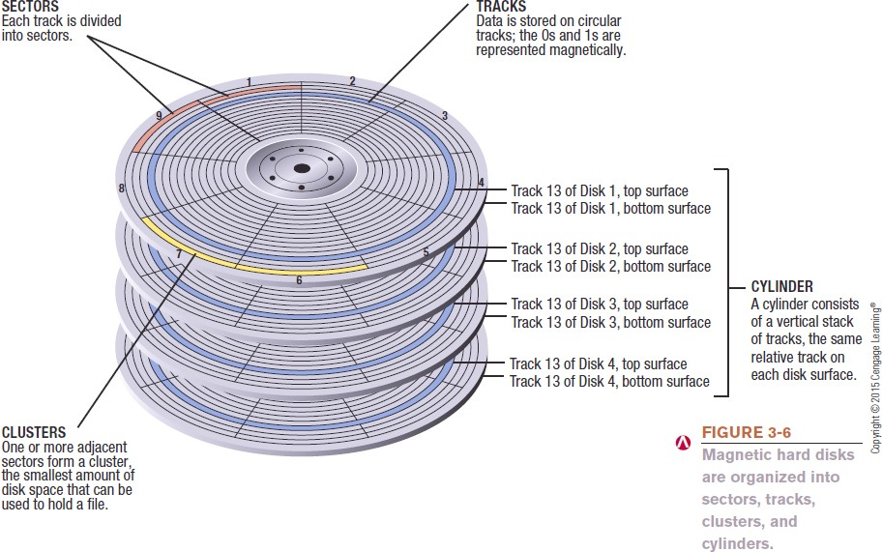
Hard Drives

Slide 18
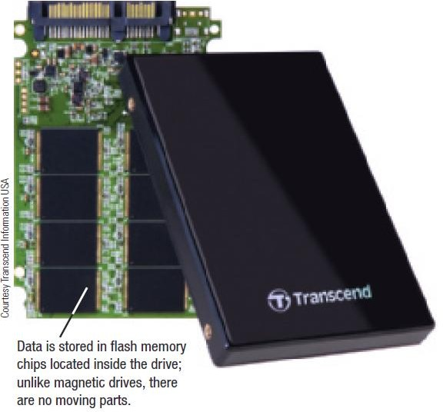

Hard Drives
Solid State Drives (SSDs)
Use flash memory technology
Use less power and have no moving parts
Particularly appropriate for portable computers and mobile devices

Slide 19
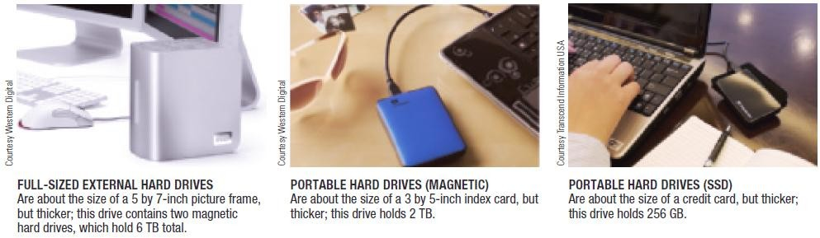

Internal and External Hard Drives

Slide 20
Hard Drive Speed, Disk Caching, and Hybrid Hard Drives
Disk access time
Total time that it takes for a hard drive to read or write data
Consists of seek time, rotational delay, and data movement time
SSDs don’t require seek time or rotational delays
Disk cache
Memory used in conjunction with a magnetic hard drive to improve system performance
Typically consist of memory chips on a circuit board inside the hard drive case

Slide 21
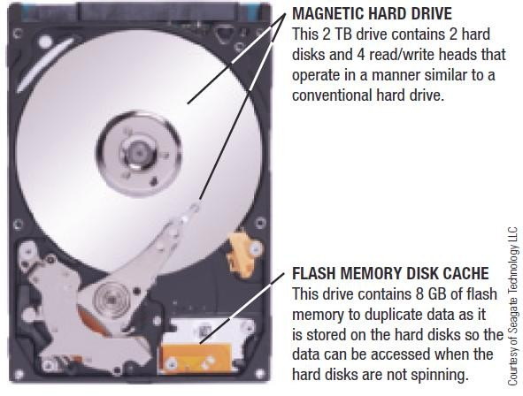
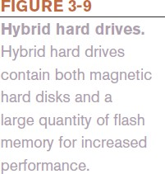
Hard Drive Speed, Disk Caching, and Hybrid Hard Drives
Hybrid Hard Drive
Combination of flash memory and magnetic hard drive
Uses flash memory for cache
Allows encryption to be built into the drive

Slide 22
Optical Discs and Drives
Optical Disc Characteristics
A type of storage read from and written to using laser beams
Today’s standard for software delivery
Divided into sectors like magnetic discs but use a single spiral track (groove)
Have a relatively large capacity and are durable
Used for backup purposes and for storing and transporting music, photos, video, etc.

Slide 23
Optical Discs and Drives
Representing Data on an Optical Disc
Read-only optical disc
Surface of disc is molded or stamped
Recordable or rewritable disc
Optical drive is used and the reflectivity of the disc is changed using a laser to represent the data
Pits and lands are used to represent 1s and 0s
The transition between a pit and a land represents a 1; no transition represents a 0

Slide 24
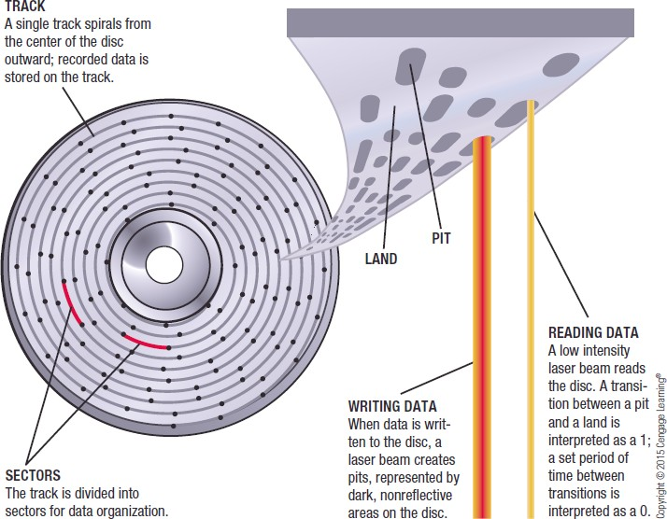

Optical Discs and Drives

Slide 25
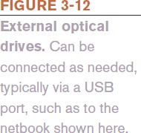
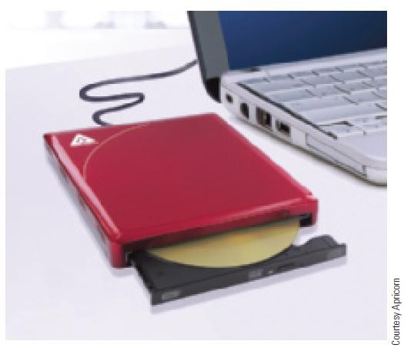
Optical Discs and Drives
Optical Drives
Three categories of discs: CD, DVD, or Blu-Ray Disc (BD)
Can be read-only, recordable, or rewritable
Almost always downward compatible
Can support single or dual layer discs
Recording data onto disc is called burning
Can be internal or external drives
External drives typically connect via USB port

Slide 26
Optical Discs and Drives
Optical Disc Shapes, Sizes, and Capacities
Standard size is 120-mm (about 4.7 inches)
Mini discs are smaller—80-mm
Theoretically can be made into various shapes—hearts, triangles, irregular shapes, or a hockey-rink shape
Patent battle exists about changing optical disc shapes
None of these different shapes are currently available

Slide 27
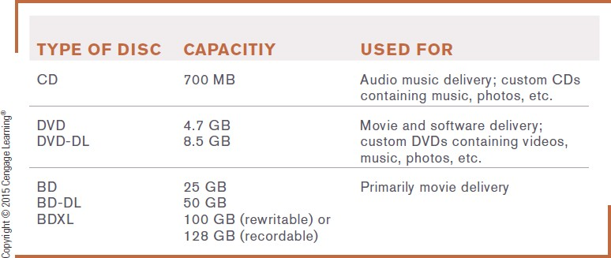

Optical Discs and Drives

Slide 28
Flash Memory Storage Systems
Flash Memory
Chip-based storage medium that represents data using electrons
Used in SSDs and hybrid hard drives
Embedded Flash Memory
Flash memory chips embedded into products, such as
Portable digital media players, digital cameras
Handheld gaming devices, GPS devices, mobile phones
Sunglasses and wristwatches

Slide 29
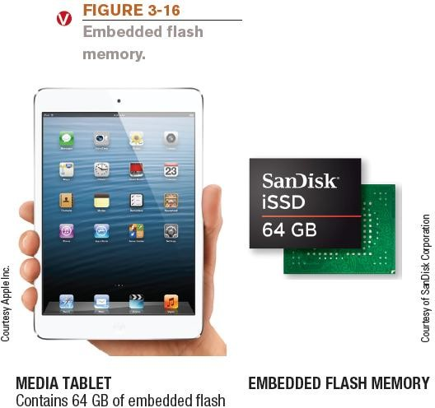
Flash Memory Storage Systems

Slide 30
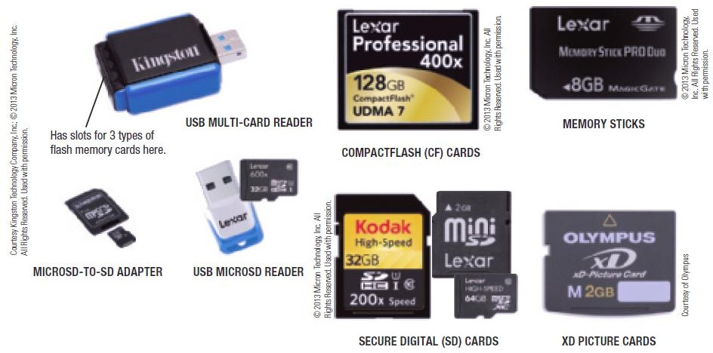
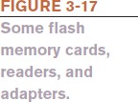
Flash Memory Storage Systems

Slide 31
Flash Memory Storage Systems
USB Flash Drives
Sometimes called flash memory drives, jump drives, or thumb drives
Flash memory media integrated into a self-contained unit that plug into and is powered by a USB port
Designed to be very small and very portable
Available in a host of formats including custom shapes
Can be built into a consumer product
Can be used to lock a computer and to issue Web site passwords
Can include biometric features, such as a built-in fingerprint reader

Slide 32
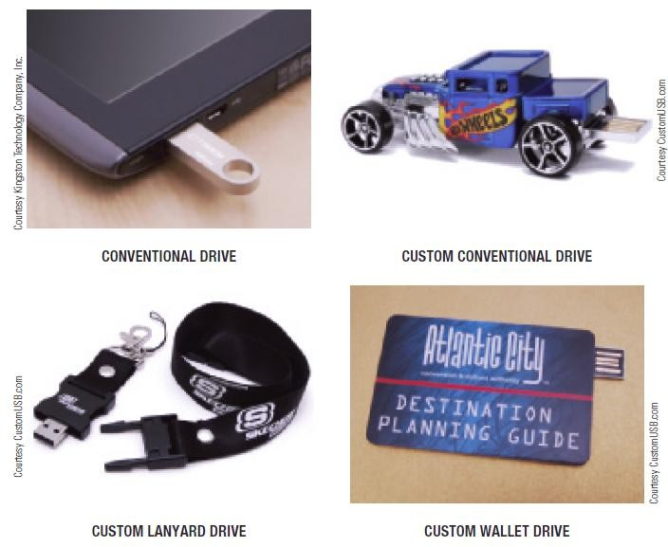

Flash Drive Storage Systems

Slide 33
Other Types of Storage Systems
Network Storage and Cloud Storage Systems
Remote storage
Using a storage device not directly connected to the
computer being used
Accessed through the Internet or through a network
Network storage
Remote storage via local network

Slide 34
Network and Cloud Storage Systems
Network attached storage (NAS)
High performance storage systems connected individually to a network
Designed for small business and home use
Storage area network (SAN)
Separate network of hard drives or other storage devices
which are attached to the main network

Slide 35
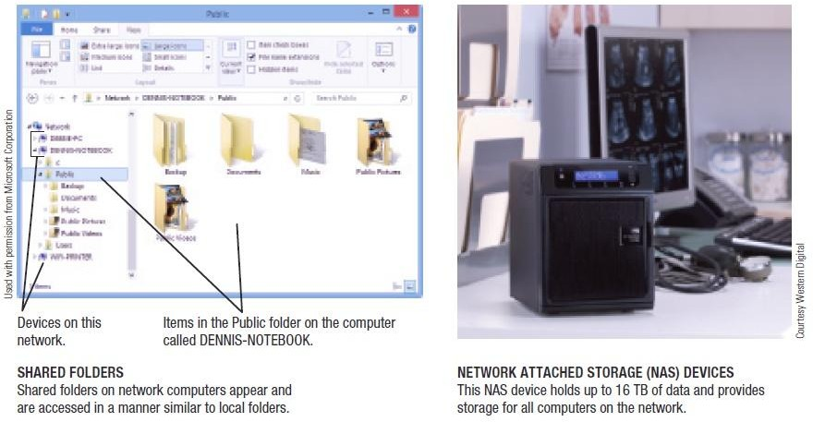

Network and Cloud Storage Systems

Slide 36
Network and Cloud Storage Systems
Cloud storage (online storage)
Accessed via the Internet
Via Web sites (Flickr, Facebook, Google Docs, etc.)
Via online storage sites (Box, Dropbox, etc.)
Growing in importance because more and more applications are Web based
Increasing being used for backup purposes
Files can be synched between PC and cloud storage
Many Web sites providing online storage offer it free
Business cloud storage is available

Slide 37
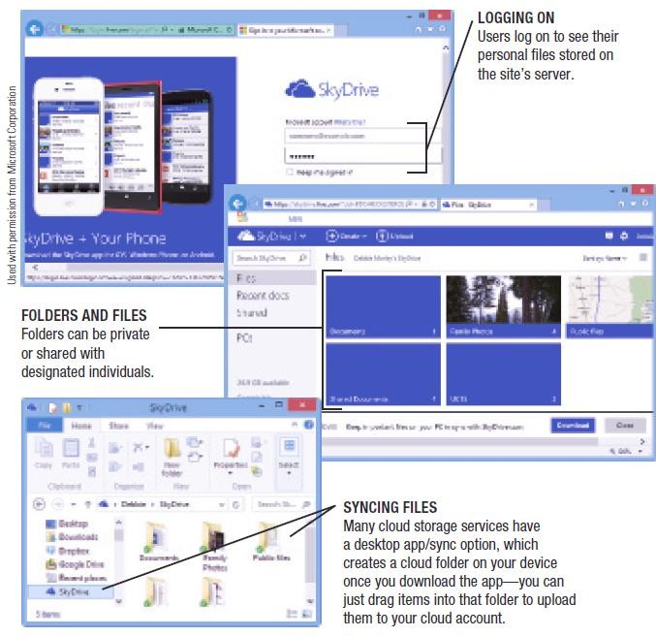

Network and Cloud Storage Systems

Slide 38
Smart Cards
Smart Card
Credit card-sized piece of plastic that contains some computer circuitry (processor, memory, and storage)
Stores small amount of data (about 64 KB or less)
Commonly used to store prepaid amounts of digital cash or personal information
Smart card readers are built into or attached to a computer, door lock, vending machine, or other device
Some smart cards store biometric data
Use of mobile smart cards is an emerging trend

Slide 39
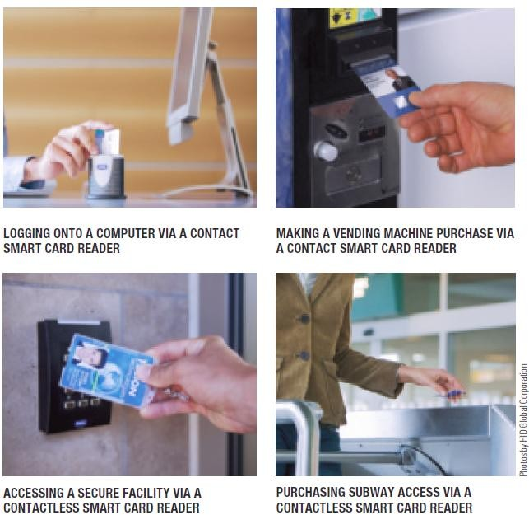

Smart Cards

Slide 40
Holographic Storage
Holographic storage
Holographic drives connect to a computer via a serial attached SCSI (SAS) or Fibre Channel interface
Uses multiple blue laser beams to store data in three dimensions
Reference beam and signal beam
Suited to applications in which large amounts of data need to be stored or retrieved quickly but rarely changed
Archiving business data, medical records, TV shows,
sensor data , etc.

Slide 41
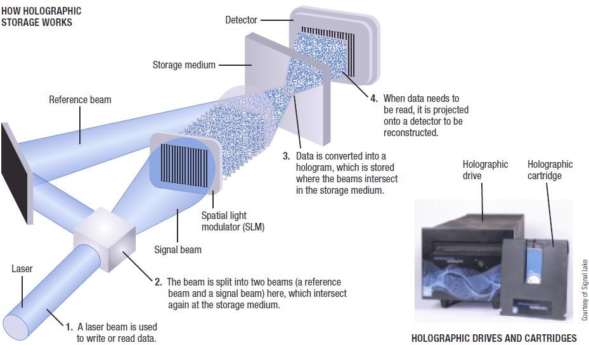
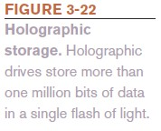
Holographic Storage

Slide 42
Storage Systems for Large Computer Systems
Business storage needs are growing exponentially
Digital data produced is expected to double every two years through 2020
Storage server
Hardware device containing multiple high-speed hard drives connected to the computer system or network
Most are based on magnetic hard discs

Slide 43
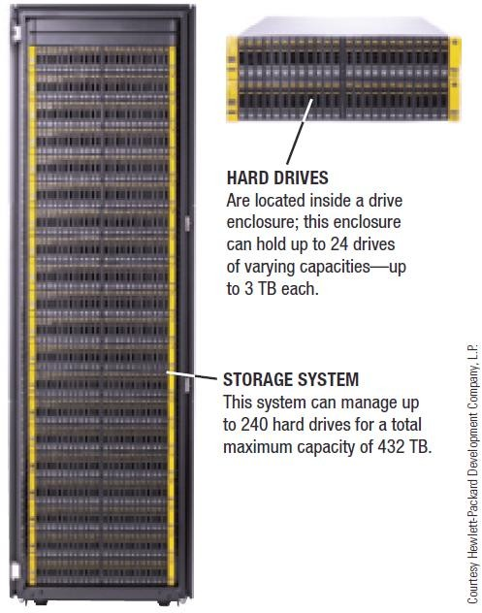
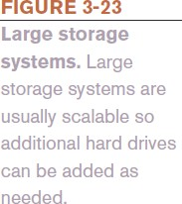
Storage Systems for Large Computer Systems

Slide 44
Storage Systems for Large Computer Systems
RAID (redundant arrays of independent discs)
Method of storing data on two or more hard drives that work together to do the job of a larger drive
Mostly used to protect critical data on large storage systems
Usually involves recording redundant copies of stored data
Helps to increase fault tolerance

Slide 45
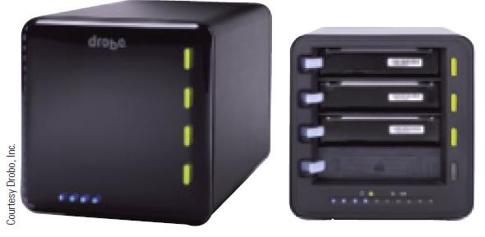

Storage Systems for Large Computer Systems
Different levels of RAID:
RAID 0 = disk striping (spread files over two or more hard drives)
RAID 1 = disk mirroring (duplicate copy)
Other level use a combination or striping and mirroring
Drobo system
New RAID storage system
Much easier to use than previous systems
Offers continuous data redundancy

Slide 46
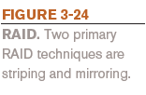
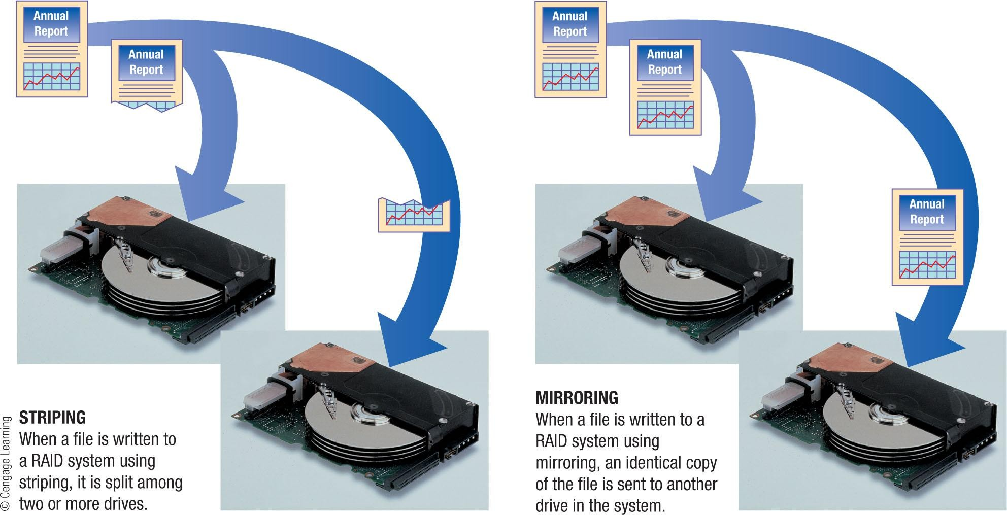
Storage Systems for Large Computer Systems

Slide 47
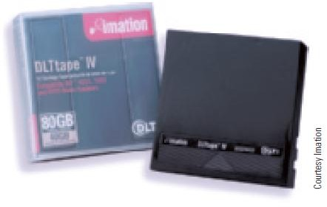
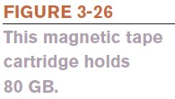
Magnetic Tape Systems
Magnetic Tape
Plastic tape coated with a magnetizable substance that represents the bits and bytes of digital data
Primarily used for backup and archival purposes
Sequential access only
Low cost per terabyte
Most tapes today are in the form of cartridge tapes

Slide 48
Evaluating Your Storage Alternatives
Product Characteristics to Consider:
Speed
Compatibility
Storage capacity
Convenience
Portability
Most Users Require:
Hard drive
Recordable or rewritable optical drive
Flash memory card reader
USB ports

Slide 49
Summary
Storage Devices:
Magnetic Storage Devices
Optical Storage Devices
Solid State Storage Devices
Data Read & Write Process.

